Slide 1

BYOD Lab: z/OSMF Hands-On Labs
your lab and grab a self-guided handout:
Get a slip with your userid and password
Follow instructions in the handout to perform your lab, on your own laptop.
You might need to turn off your VPN to get to the lab website.
IBM Change Tracker for z/OS
Installing PTFs with z/OSMF Software Update
Getting started with z/OS DG REST Services
Getting started with IBM SMF Explorer
Incident Log
Security Configuration Assistant
z/OSMF Consoles
Sysplex Management
z/OSMF Desktop
Diagnostic Assistant
Learning Workflows (with z/OS Upgrade Workflow)
Create your own Workflow with the Workflow Editor
Installing a z/OSMF Portable Software Instance
z/OSMF WLM
This is a z/OS 3.1 z/OSMF system, running on IBM z16!
Don’t forget to do an evaluation!

Slide 2
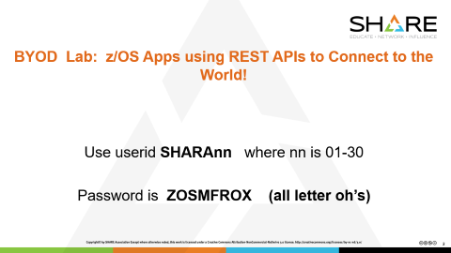
BYOD Lab: z/OS Apps using REST APIs to Connect to the World!
Use userid SHARAnn where nn is 01-30
Password is ZOSMFROX (all letter oh’s)

Slide 3
Hands-On Labs
z/OS Apps Using REST APIs
to Connect to the World!

Slide 4
Hands-On Labs
z/OS Apps Using REST APIs
to Connect to the World!

